Slide 1
Machine Learning Quarter 2 Project Presentation
Vishal Kotha, Arnav Jain
Dr. Yilmaz’s Period 1 Machine Learning 2 Class
February 6, 2023

Slide 2
Overview
Statement/Project Goal
Description of Dataset
Attribute Selection/Preprocessing
Model Classifiers
Results and Analysis
Conclusion
Appendix/Sources

Slide 3

Our Goal
Creating an appropriate model that predicts whether or not cars bought at an auction are unsellable for dealerships due to some malfunction (termed a “kick”)
Achieving a testing accuracy that is viable for actual prediction

Slide 4
Our Dataset
Our dataset included data with 32 attributes and 72,983 instances of car information.
Heavy Class Imbalance
The attributes included information about the car like the information pertaining to the auction it was sold at and characteristics specific to the car (like color)

Slide 5
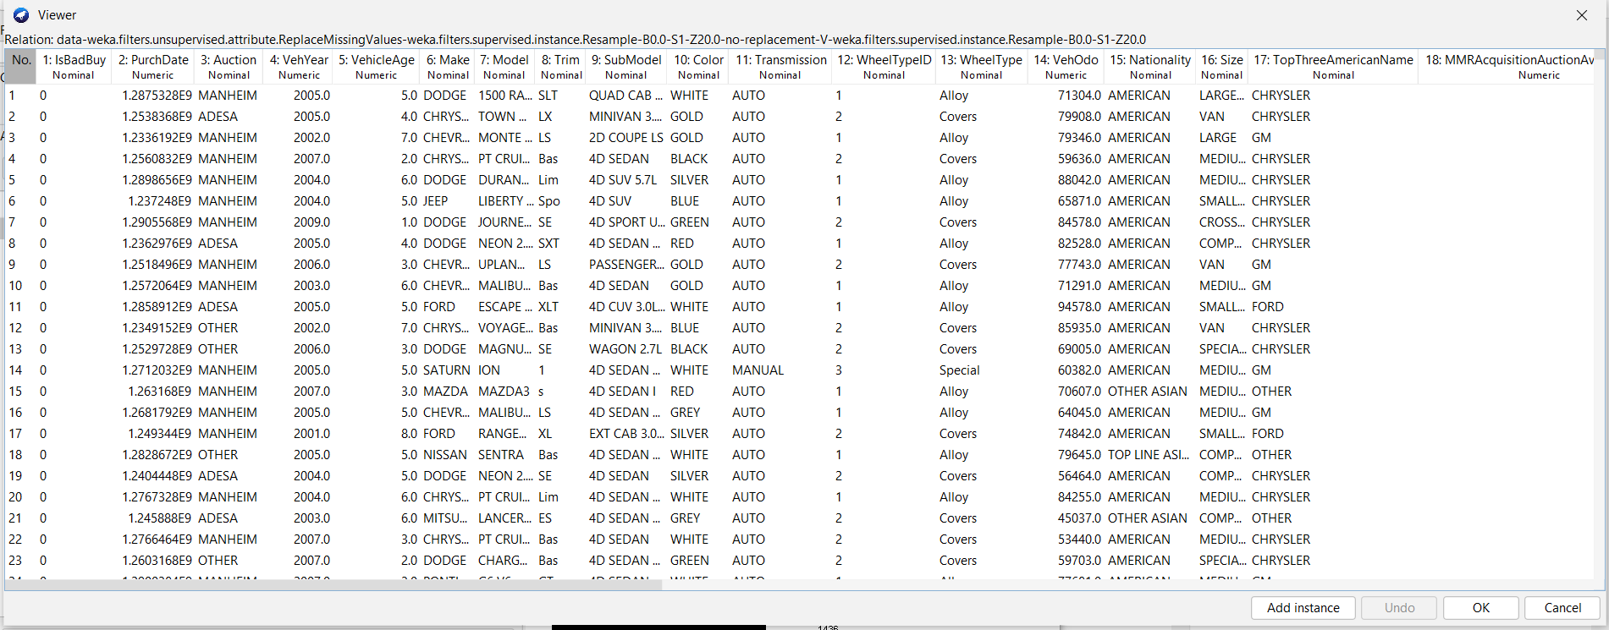
Data Snippet
Labels (isBadBuy) | 0 (“not a kick”) | 1 (“was a kick”)

Slide 6
Preprocessing/Modeling

Slide 7
Preprocessing Part 1
Data was split into training/testing with 80-20 random stratified split
Numerical data was separated from categorical
Numerical Attributes with missing data were filled in with the mean
Categorical Attributes with missing data were filled in with most frequent value
Train and test datasets too large; we stratified sampled 20% without replacement and made samples the new datasets
All these steps were performed using WEKA

Slide 8
Attribute Selection
In order to optimize our following model and save time, attribute selection was necessary as part of preprocessing.
Four different attribute selectors in the WEKA software were used for this: Correlation Attribute Evaluation, Information Gain Attribute Evaluation, Gain Ratio Attribute Evaluation, and reliefF Attribute Evaluation.
For each of the attribute selectors, a ranker was used and we used a threshold to select features (0.09 for correlation; 0.05 for reliefF; 0.007 for information gain; 0.005 for gain ratio)

Slide 9
Attribute Selectors
Correlation Attribute Evaluation: Compares the Pearson correlation coefficient between the attribute and class variables
Info Gain Attribute Evaluation: Compares the information gain between only the class variable versus the class variable with the attribute
Gain Ratio Attribute Evaluation: Compares the ratio of information gain between the class and the attribute
ReliefF Attribute Evaluation: Compares each attribute’s distance for the nearest “hit” and “miss” and updates weights accordingly

Slide 10
Our Model
4 models were used
Random Forest
J48 Decision Tree
AdaBoost M1
Naive Bayes
All models implemented on WEKA

Slide 11
Results and Analysis

Slide 12
Our Results
We have attached tables summarizing and comparing different performance metrics.
Testing Accuracy (%)
 | Random Forests | Naive Bayes | J48 | Adaboost
Normal Dataset | 87.4957 | 75.4711 | 87.7013 | 87.7013
Correlation | 87.1531 | 74.8201 | 86.9818 | 87.7013
ReliefF | 87.0846 | 83.1792 | 87.7013 | 87.7013
Gain Ratio | 86.1254 | 75.9164 | 87.7013 | 87.7013
Information Gain | 87.2902 | 76.3275 | 87.7013 | 87.7013
Model
Attribute Selector

Slide 13
Our Results
Weighted True Positive Rate
 | Random Forests | Naive Bayes | J48 | Adaboost
Normal Dataset | 0.875 | 0.755 | 0.877 | 0.877
Correlation | 0.872 | 0.748 | 0.87 | 0.877
ReliefF | 0.871 | 0.832 | 0.877 | 0.877
Gain Ratio | 0.861 | 0.759 | 0.877 | 0.877
Information Gain | 0.873 | 0.763 | 0.877 | 0.877
Model
Attribute Selector

Slide 14
Our Results
Weighted False Positive Rate
 | Random Forests | Naive Bayes | J48 | Adaboost
Normal Dataset | 0.851 | 0.571 | 0.877 | 0.877
Correlation | 0.854 | 0.557 | 0.856 | 0.877
ReliefF | 0.84 | 0.807 | 0.877 | 0.877
Gain Ratio | 0.817 | 0.57 | 0.877 | 0.877
Information Gain | 0.842 | 0.567 | 0.877 | 0.877
Model
Attribute Selector

Slide 15
Our Results
AUC
 | Random Forests | Naive Bayes | J48 | Adaboost
Normal Dataset | 0.649 | 0.659 | 0.5 | 0.679
Correlation | 0.665 | 0.641 | 0.579 | 0.666
ReliefF | 0.607 | 0.642 | 0.5 | 0.514
Gain Ratio | 0.618 | 0.652 | 0.5 | 0.671
Information Gain | 0.65 | 0.661 | 0.5 | 0.669
Model
Attribute Selector

Slide 16
Our Results
Recall (for the “kick” instances)
 | Random Forests | Naive Bayes | J48 | Adaboost
Normal Dataset | 0.031 | 0.376 | 0 | 0
Correlation | 0.028 | 0.393 | 0.025 | 0
ReliefF | 0.045 | 0.089 | 0 | 0
Gain Ratio | 0.072 | 0.376 | 0 | 0
Information Gain | 0.042 | 0.379 | 0 | 0
Model
Attribute Selector

Slide 17
Most Important Features
These typically varied from attribute selection algorithm to attribute selection algorithm; however, these were pretty high overall
Model
Submodel
VehicleAge

Slide 18
Why accuracy is bad metric?
Heavy class imbalance (lot more “not a kick” instances than “kick” instances)
Some models just predicting “not a kick” for every instance
Results in a high accuracy, weighted true positive rate, and weighted false positive rate
Use of alternate metrics to better evaluate performance:
AUC
Recall (only for negative class)

Slide 19
Analysis/Conclusion
We were able to achieve a maximum recall of .393 with correlation attribute selection for naive bayes which is slightly higher than our highest recall without attribute selection, which was 0.376. Therefore, attribute selection was beneficial for this dataset.
In general, the naive bayes model performed the best, followed by the random forest, with the J48 decision tree and the Adaboost M1 classifier performing poorly (usually predicted “not a kick” every time)
All of the models achieved recalls from 0-0.1 except for the Naive Bayes; the Naive Bayes achieved a max recall of 0.393. Although this may not be high enough for definite classification, it could serve as an intermediary that other classifiers and researchers could reference.

Slide 20
Appendix/Sources

Slide 21
Sources/References
Data Source: https://www.openml.org/search?type=data&sort=runs&id=41162&status=active
Models:
https://weka.sourceforge.io/doc.dev/weka/classifiers/trees/RandomForest.html
https://weka.sourceforge.io/doc.dev/weka/classifiers/bayes/NaiveBayes.html
https://weka.sourceforge.io/doc.dev/weka/classifiers/trees/J48.html
https://weka.sourceforge.io/doc.packages/realAdaBoost/
Attribute Selectors:
https://weka.sourceforge.io/doc.dev/weka/attributeSelection/CorrelationAttributeEval.html
https://weka.sourceforge.io/doc.dev/weka/attributeSelection/ReliefFAttributeEval.html
https://weka.sourceforge.io/doc.dev/weka/attributeSelection/GainRatioAttributeEval.html
https://weka.sourceforge.io/doc.dev/weka/attributeSelection/InfoGainAttributeEval.html

